Slide 1
MAPPING GAME USERS & DESIGNERS NEEDS TO TECHNOLOGIES
Notes:
Mozilla tech speaker, design researcher gameChange Royal College of Art
The aims of this session is finding solutions to users needs. As a design researcher at the RCA I meet other researchers and I became interested in why they aren’t using the web in their research. From this I thought it would be an interesting workshop to look at users needs and seeing how those needs could be solved with web technologies. I’ve been interviewing a number of different users in areas that might use web games and talked to them about what they need in general from a technology and what they would need from the web

Slide 2
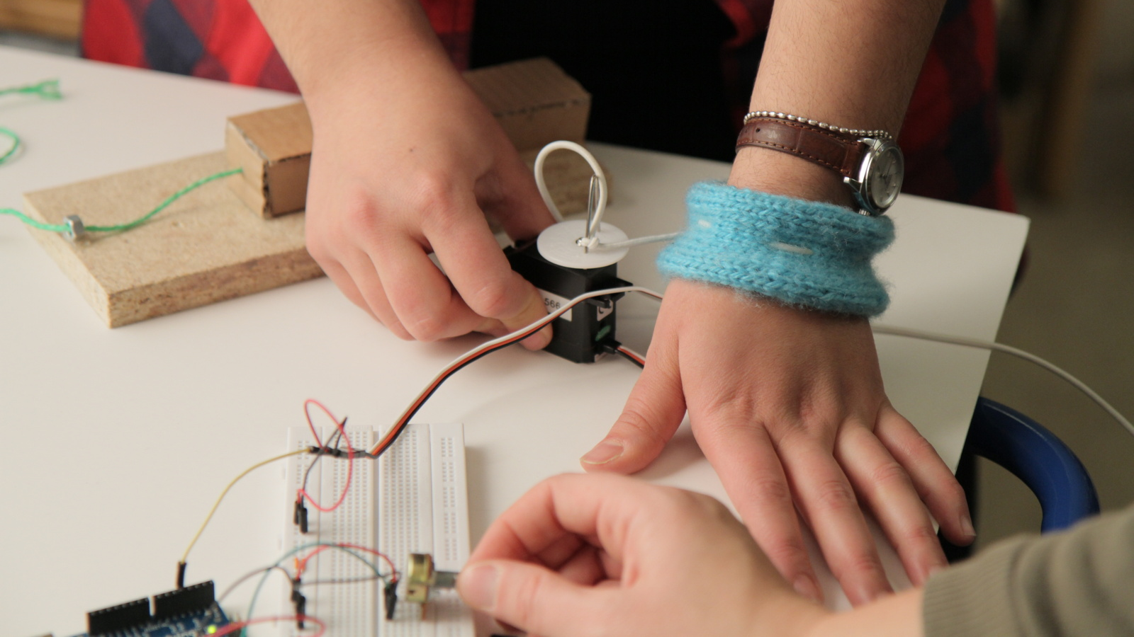
TOUCH/HAPTICS
photo by Camille Moussette
license CC BY-SA 2.0
Notes:
Talked with researchers looking at haptics and touch at University College London
Touch is made up of pressure, heat and movement but other things also affect touch including your environment, sound, body posture. Smart clothing is still really a long way off, problems with connections and recycling.
Sensors used: Bend sensors, pollution sensors, bio sensors (heart rate, galvanic skin response etc), proximity, accelerometer

Slide 3
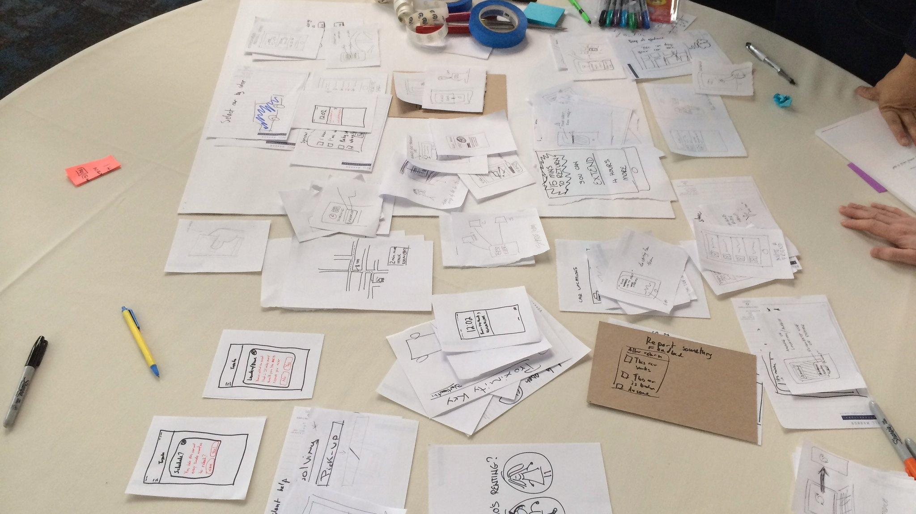
UX DESIGNER
photo by Zeke Franco
license CC BY-NC-ND 2.0
Notes:
Talked to a UX designer with an interest in Web VR
Designing solutions that are efficient for the user, thinking of transactional experience, how people get to where they need to be, the feedback loop, thinking about how people will engage with 2D content in a 3D or immersive environment. VR experience is not built for efficiency. Usually start designing with paper then build prototypes, what is a simple way to do that in VR, top down not always enough, perspective grids not easy to use.

Slide 4
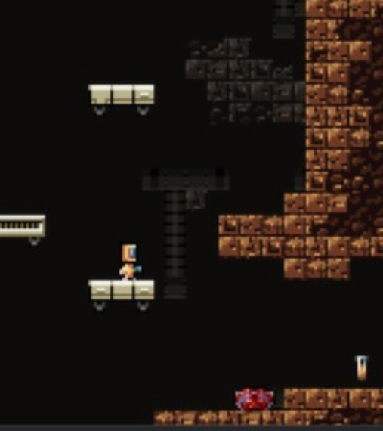
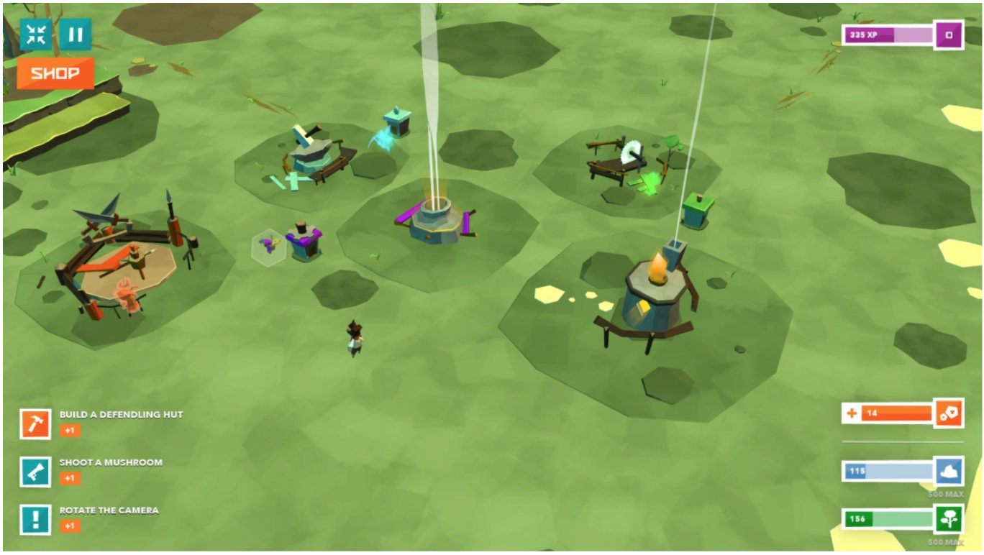
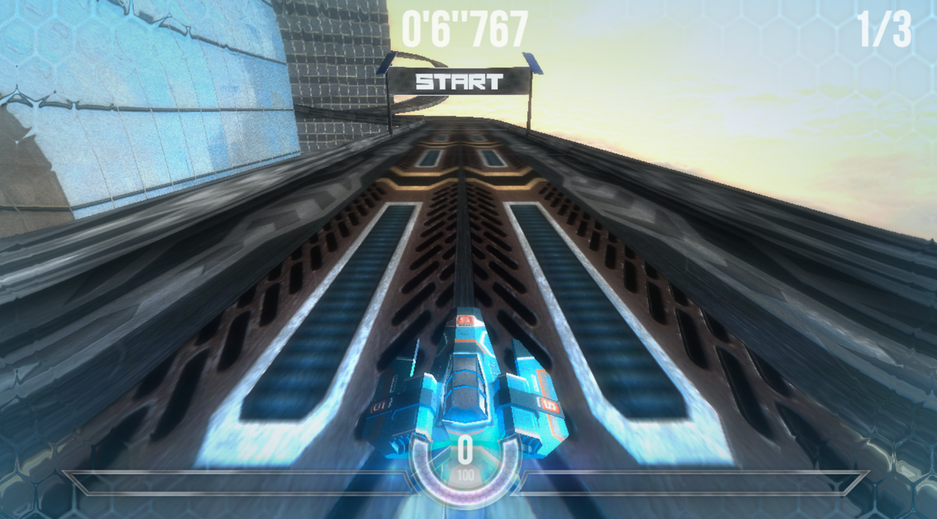
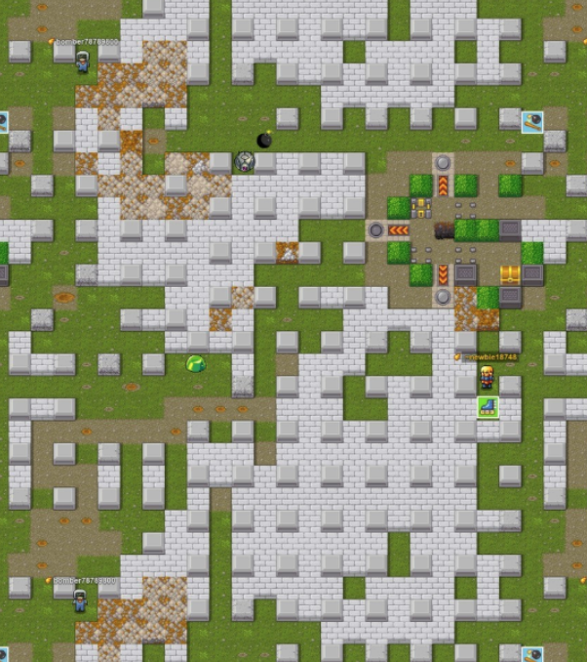
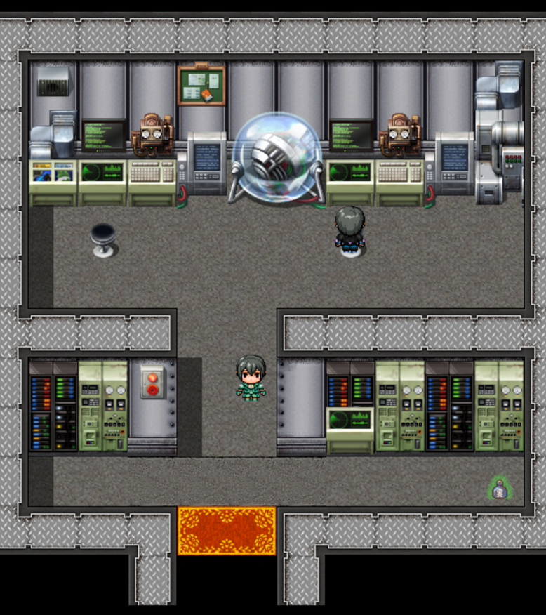
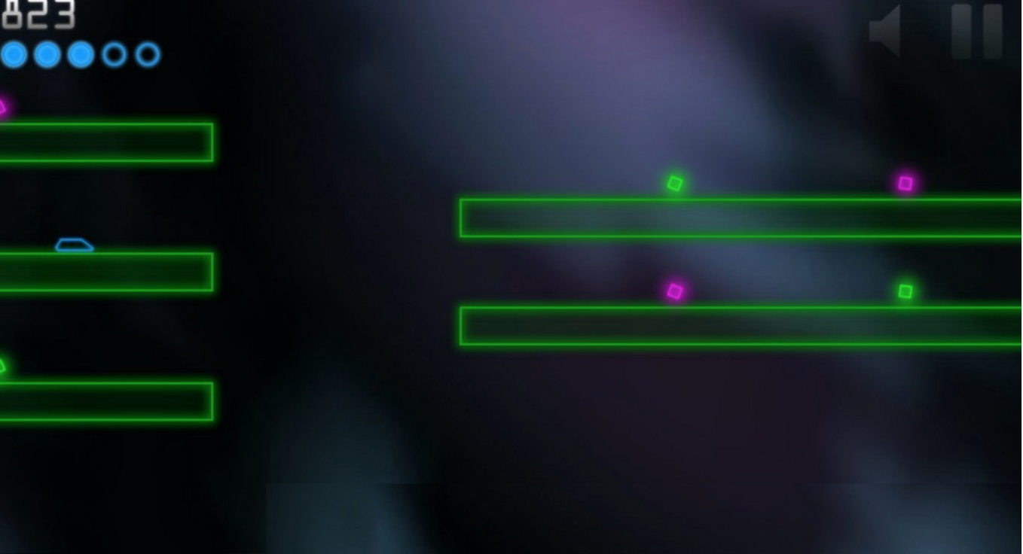
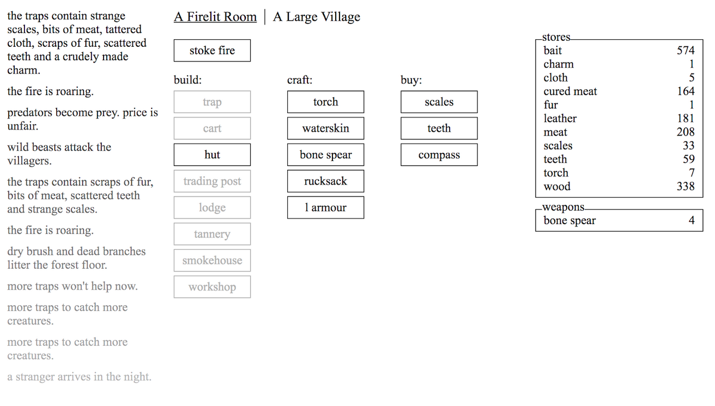
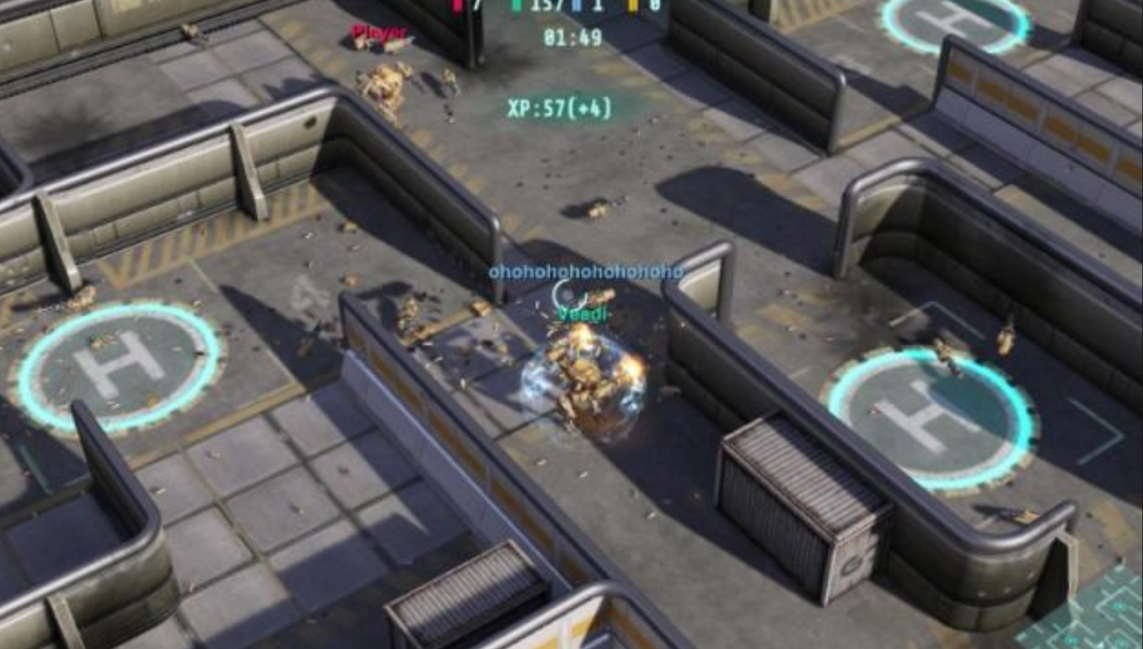
GAMERS
Notes:
3 gamers mid twenties to early thirties
I usually play console games for graphics, gameplay and narrative as I really enjoy visually impressive looking games, Gameplay is usually more varied than web games, and you can play some unique experience, console games usually have greatly crafted narratives. The console title F-Zero X, has 30 vehicles, great soundtrack tighter gameplay.
Used to playing with different technologies, used to gaming with consoles or with mobile devices, used to backstories a whole narrative around a game, want motivations, UI information. A wide range of game types for different gamers

Slide 5
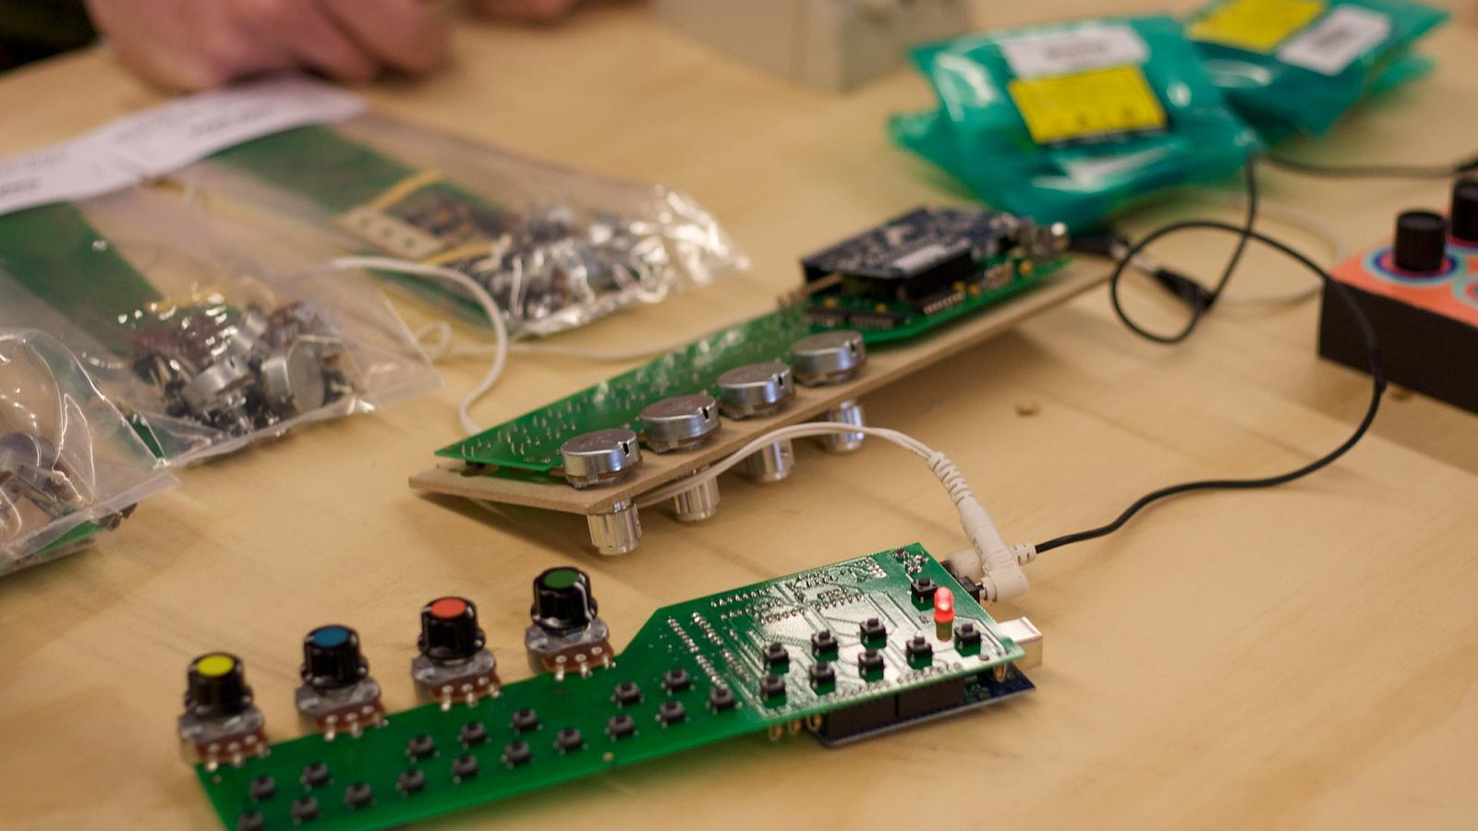
HARDWARE DEVELOPER
photo by Nathan Yergler
license CC BY-SA 2.0
Notes:
Spoke with a hardware developer from a start upworking on a product to interact with AR on phones
Would like to be able to use the web as it would mean making one version not multiple apps but the web is too unreliable and they only want to develop with standards they can rely on. Mobile Safari has removed access to phones sensors, Motion tracking is no longer default on iOS - it’s opt in, No bluetooth interactions on the browser. The standard are coming too slowly, the web is innovating too slowly compared to private companies.

Slide 6
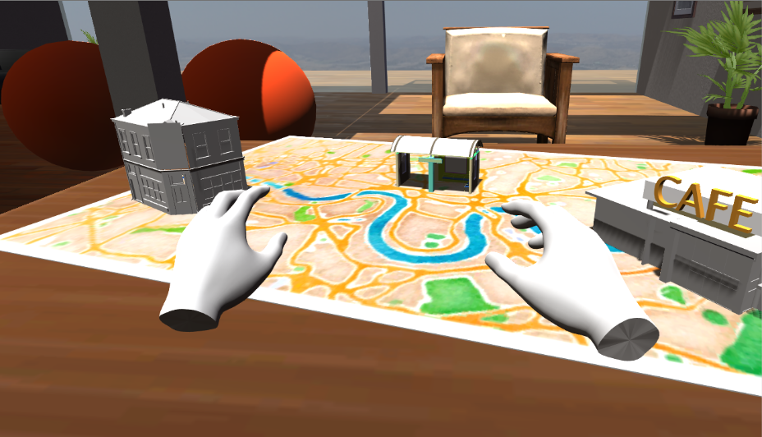
SERIOUS GAMES
Prototype by Paul Eliasz
Notes:
Thinking about the work I’ve been doing over the past year on the VR therapy gameChange, a therapy for people with psychosis to help them feel less anxious in everyday situations. Worked closely with people with lived experience of psychosis, psychologists and The things we were thinking about when designing were giving people agency in their treatment, it’s an engaging therapy and easy to use. We made prototypes during the design process that we could take to workshops. These prototypes were built in Unity

Slide 7
THE WORKSHOP
split into 3 groups
What are users needs
Create a matrix of needs and technologies
Speculate on the future and how to get there
Notes:
Split into 3 groups, work on what the users needs are, create a matrix of need and technology, speculate on the future and how to get there

